Slide 1

Department of Computer Science and Engineering
(Cyber Security)
CS23533– Foundations of Artificial Intelligence
2026-2027
FraudShield AI — Intelligent Digital Payment Risk Assessment System
Supervisor
Dr. S. Bhuvana
Assistant Professor (SG)
Team Members
Deepan S A (241901021)
Barathraj M (241901015)

Slide 2
Problem Statement and Motivation
Problem: decide quickly whether a digital payment is risky, and tell the reviewer exactly why.
Why it is hard: fraud signals are spread over many inputs; a single threshold misses combinations, and black-box scores cannot be justified to customers or auditors.
Who is affected: customers and banks exposed to payment fraud, and fraud analysts who must justify blocking or allowing a transaction.
Motivation: build a transparent, rule-based expert system that needs no training data and explains every decision.

Slide 3
Objectives
To model a digital payment as facts built from seven core inputs: amount, time, device trust, location, login behaviour, frequency and account activity.
To capture fraud knowledge as predicate-logic IF–THEN rules in a readable knowledge base.
To implement forward chaining that derives risk conclusions from the facts, with no training data.
To apply conflict resolution when several rules fire and assign one of four tiers: LOW, MEDIUM, HIGH or CRITICAL.
To make every decision explainable (XAI) by showing the rules that fired and why.
To deliver a FastAPI + React web application with sample transactions TXN001 and TXN002, started on Windows 10/11 with run.bat.

Slide 4
Abstract
Digital payment fraud is hard to catch with a single threshold, and machine-learning scores are hard to justify. FraudShield AI is a symbolic, rule-based expert system that assesses a payment from seven core inputs: amount, time, device trust, location, login behaviour, frequency and account activity. The inputs become facts and predicates; a forward-chaining engine fires IF–THEN rules to derive risk conclusions; conflict resolution picks the governing rule; and the transaction is placed in one of four tiers: LOW, MEDIUM, HIGH or CRITICAL. Every decision carries the rules and reasons behind it (explainable AI), and no training data is needed. The backend uses FastAPI, Pydantic, SQLAlchemy and SQLite; the frontend uses React, TypeScript, Vite and Tailwind. A versioned base of 32 rules over 31 predicates is demonstrated on 76 evaluations (74 synthetic demonstration records, including TXN001 critical and TXN002 normal) with an average evaluation time of 1.83 ms.
Keywords: expert system, predicate logic, forward chaining, conflict resolution, explainable AI, fraud detection

Slide 5
Literature Survey
S. No. | Author(s) & Year | Paper Title | Methodology / Algorithm | Limitations
1 | C. L. Forgy (1982) | Rete: A Fast Algorithm for the Many Pattern/Many Object Pattern Match Problem | Network that shares condition tests between rules, so forward chaining re-matches only changed facts | Speeds up matching only; memory-hungry; supplies no domain rules and no explanation
2 | B. G. Buchanan, E. H. Shortliffe (1984) | Rule-Based Expert Systems: The MYCIN Experiments of the Stanford Heuristic Programming Project | IF–THEN rules with certainty factors; advice is explained by showing the rules used | Rules written by hand; certainty factors are ad hoc; slow knowledge acquisition
3 | R. J. Bolton, D. J. Hand (2002) | Statistical Fraud Detection: A Review | Surveys statistical, supervised and unsupervised methods for finding fraud | Needs data and fraud labels; scores rarely say why a case was flagged

Slide 6
Literature Survey
S. No. | Author(s) & Year | Paper Title | Methodology / Algorithm | Limitations
4 | A. Dal Pozzolo et al. (2018) | Credit Card Fraud Detection: A Realistic Modeling and a Novel Learning Strategy | Machine-learning classifiers for imbalanced, delayed-label card transactions, with analyst feedback | Requires a large labelled history; concept drift; the classifier is a black box
5 | M. T. Ribeiro, S. Singh, C. Guestrin (2016) | “Why Should I Trust You?”: Explaining the Predictions of Any Classifier | LIME: fits a simple local model around one prediction to explain it | The explanation is an approximation added afterwards, not the logic that decided

Slide 7
Research Gap / Existing System
1. What existing studies do
Expert systems encode knowledge as IF–THEN rules with explanations [2] and match them efficiently [1]; fraud research mostly uses statistical and machine-learning detection [3], [4]; explanation tools such as LIME are added afterwards [5].
2. Limitations observed
ML detectors need labelled data and act as black boxes; post-hoc explanations only approximate the model; classic expert systems are not packaged for payment risk or a modern web workflow.
3. Research gap
No compact, self-contained tool combines predicate-logic rules, forward chaining, conflict resolution and built-in explanation for payment risk, without training data and installable from one ZIP.
4. How our project responds
FraudShield AI: seven inputs → predicates → forward chaining → conflict resolution → four risk tiers, with the fired-rule trail as the explanation, in a web app started by run.bat.

Slide 8
Proposed System
A staged expert-system pipeline replaces ad-hoc checks. Each stage adds exactly one idea to the stage below, so the gap between two stages is the value of that idea.
4
Conflict + XAI
3
Forward Chaining
+ decision: conflicts resolved; one of four tiers, an action and the rule trail.
2
Predicates
+ inference: rules fire on known facts and add derived risk facts until none remain.
1
Facts
+ logic: facts become predicates such as HighAmount(t) in IF–THEN rules.
Seven core inputs become typed facts about the transaction.
7 core inputs
validated facts
31 predicates
observed + behavioural
32 active rules
no training data
4 risk tiers
explained decision
Around the engine:
Dashboard
Analytics
Reports
Audit logs
Rule Explorer · Knowledge Base
Same facts always give the same tier and the same rule trail: the core is deterministic and symbolic; machine learning is only a designed extension point.

Slide 9
DFD Diagram – Level 0
Level 0 – context diagram: the whole system as one process and the people who exchange data with it.
0
FraudShield AI
rule-based risk assessment
transaction details (7 core inputs)
review requests: history, reports, audit logs
Analyst
(fraud reviewer / user)
Evaluator
(reviewer / tester)
risk tier, fired rules, explanation
PDF reports, audit trail
Notation:
external entity
process
D
data store
data flow

Slide 10
DFD Diagram – Level 1
Level 1: process 0 broken into six processes and three data stores.
1.0
Load Rules & Knowledge Base
rule definitions
D2
Transactions
D1
Rule Base
save / load txn
rules, predicates
rule ids
Analyst
2.0
Validate & Derive Facts
derived
facts
3.0
Forward Chaining Inference
Evaluator
transaction details (7 inputs)
fact view
fact
base
request
fired rules
PDF report
risk tier, explanation
6.0
Explain & Display Result
4.0
Resolve Conflicts & Assign Tier
5.0
Log Decision & Report
D3
Audit Log
tier +
rules
tier,
decision
Notation:
external entity
process
D
data store
data flow

Slide 11
Methodology / Workflow Diagram
1
INPUT
2
PREPROCESSING
3
PREPROCESSING
4
DESIGN
Transaction input
Validate
Baseline & facts
Knowledge base
Amount, time, device trust, location, login, frequency, account activity
Pydantic checks every field; constraint evaluation rejects invalid input
User baseline and features become facts, e.g. HighAmount(x), NewLocation(x)
32 versioned IF–THEN rules over 31 predicates, each with a severity
5
IMPLEMENTATION
6
IMPLEMENTATION
7
TESTING
8
EVALUATION · OUTPUT
Match & chain
Resolve & classify
Verify
Recommend & audit
Unify rules with facts, fire each once, stop at a fixpoint
Priority, specificity, severity, id; then tier and 0–100 index
Six startup checks pass; pytest and Playwright suites for the code
Approve, MFA, block or analyst review, with rule trail, PDF and audit log
Feedback loop: findings from testing and the demo data go back into steps 3–6 to refine predicates, rules and conflict order.

Slide 12
Tools and Technologies
Category | Used in this project | Why
Programming languages | Python · TypeScript · SQL · HTML5 · CSS3 | Python for the rule engine and API; TypeScript for a type-safe UI
Libraries / frameworks | FastAPI · Pydantic · SQLAlchemy · SQLite · React · Vite · Tailwind CSS | Typed validation from request to database; fast modern frontend
Software / tools | pytest · Playwright · run.bat · Docker (optional) | Automated tests; one-click start on Windows
Hardware | Any CPU-only PC or laptop running Windows 10/11 | Rule-based inference needs no GPU
Dataset | No training dataset: knowledge is written as rules. 74 clearly labelled synthetic demonstration transactions (incl. TXN001 critical, TXN002 normal) | Rules replace training data; synthetic records only demonstrate behaviour

Slide 13
List of Modules
Knowledge Base
31 predicates · 32 rules
Dependencies point one way
M1
Predicates, facts and 32 versioned IF–THEN rules over the seven inputs
M3 Interface
M2
Inference Engine
forward chaining
Rule matching, forward chaining, conflict resolution and risk tier
M2 Inference
M4 Data
M5 Explain
M3
Interface
FastAPI · React
React + TypeScript console (10 pages) and FastAPI service
M1 Knowledge
M4
Data
SQLAlchemy · SQLite
Storage of evaluations, reports and audit logs; synthetic demo data
The knowledge base knows nothing else; inference uses its rules; data and explanation use both; the interface sits on top.
All five modules built and running; all 6 startup checks pass.
M5
Explanation
XAI · PDF
Reasoning chain, PDF report and audit trail behind every decision

Slide 14
Module Description – M1 Knowledge Base
Purpose: holds the domain knowledge: predicates, facts and IF–THEN rules that define what a risky payment looks like.
31 predicates, such as HighAmount(x), NewLocation(x) and UntrustedDevice(x), are either observed from the input or behavioural, derived from the user's baseline.
32 active rules (rule base v1.0.0) are data: antecedents, consequent, priority, severity, category and version.
92 rule dependencies link each predicate to the rules that use it; the Knowledge Base page shows them.
Facts record their source, derivation rule and parent facts, so every fact can be traced.
No training data and no learned weights: every rule is written down and can be audited.
INPUT
Seven core inputs plus the user's behavioural baseline
M1 · Knowledge Base
OUTPUT
Predicate vocabulary, rule set and structured facts
STACK
Python · rule base v1.0.0
32
active rules

Slide 15
Module Description – M2 Inference Engine
Purpose: the AI core: matches rules to facts, forward chains to a conclusion and resolves conflicts.
Rule matching: antecedents are matched against the facts by unification, giving rule instantiations.
Forward chaining: each instantiation fires once and may add derived facts; the loop stops at a fixpoint.
Conflict resolution is deterministic: priority, then specificity, then severity, then rule id.
Risk classification: the fired rules set the tier (LOW, MEDIUM, HIGH or CRITICAL) and a 0–100 severity index.
The recommendation follows the tier: Approve, Request MFA, Temporarily block, or Flag for analyst review.
INPUT
Transaction facts and the active rule set
M2 · Inference Engine
OUTPUT
Tier, severity index, recommendation and fired rules
STACK
Pure Python; no ML in the core
1.83
ms avg time

Slide 16
Module Description – M3 Interface
Purpose: everything the analyst sees, plus the API that connects the console to the engine.
FastAPI service accepts a transaction, runs the 12-stage evaluation and returns tier, recommendation and explanation.
Pydantic validates every request; the form asks for the seven parameters before analysis.
React + TypeScript console (Vite, Tailwind): Dashboard, Analysis, History, Analytics, Rule Explorer, Knowledge Base, Reports, Audit Logs, Settings, About.
Quick scenarios fill the form; the risk level always comes from the rule engine, never from the form.
run.bat starts the system on Windows 10/11; Docker is optional.
INPUT
Seven parameters from the form, filters, report requests
M3 · Interface
OUTPUT
Tier badge, explanation, charts, history, PDF reports
STACK
FastAPI · React · Vite · Tailwind
10
pages

Slide 17
Module Description – M4 Data
Purpose: stores evaluations, reports and audit events so every decision can be reviewed later.
SQLAlchemy models map to a SQLite database (fraudshield.db, schema v1); no database server is needed.
Synthetic demonstration data is seeded and clearly labelled: 74 of the 76 stored evaluations.
Audit Logs keep a record of analyses, recommendations, alerts and reports.
Transaction History searches by user, location, device trust, rule fired, decision status and date.
Settings can export a database snapshot and re-seed the demo data.
INPUT
Evaluated transaction, fired rules, report requests
M4 · Data
OUTPUT
Stored records, history, analytics data, audit events
STACK
SQLAlchemy · SQLite
76
evaluations

Slide 18
Module Description – M5 Explanation
Purpose: makes every decision explainable: why this tier, and which rules and facts caused it.
The reasoning chain separates observed evidence, derived evidence, logical inference and the final decision.
Facts carry their source, derivation rule and parent facts, so the chain is exposed as a graph.
Nothing is approximated afterwards: unlike post-hoc tools such as LIME, the explanation is the decision path itself.
Reports page: a PDF report with executive summary, decision, input parameters and reasoning for any transaction.
The Rule Explorer and Knowledge Base pages expose the rules and predicates behind a decision.
INPUT
Fired rules, facts and final tier
M5 · Explanation
OUTPUT
Reasoning chain, PDF report, plain-language summary
STACK
Python · React · PDF export
PDF
reports

Slide 19
Results & Discussion
Risk tier | Recommended action | Evaluations
LOW | Approve | 40 (53%)
MEDIUM | Request additional identity verification (MFA) | 16 (21%)
HIGH | Temporarily block | 11 (14%)
CRITICAL | Flag for cyber analyst review | 9 (12%)
Four tiers, four actions. Each tier maps to one recommendation, from Approve to Flag for analyst review.
Most traffic is normal. 40 of 76 evaluations (53%) are LOW; 20 (26.3%) are HIGH or CRITICAL and blocked or flagged.
Fast. Average evaluation time is 1.83 ms; average severity index 21.1 (rule-based, not a probability).
Source: Analytics page, 76 stored evaluations, 74 of them synthetic demonstration records.

Slide 20
Results & Discussion
Sample transactions TXN001 and TXN002 (from Transaction History)
What the results show
Evidence, not a guess: TXN001 is flagged for a high-value amount and suspicious login behaviour on an untrusted device.
Many rules agree: re-running TXN001's inputs fired 21 rules; R40 raises the critical alert.
Normal stays quiet: TXN002's inputs fire one rule, R50 (trusted device in familiar location), so the tier is LOW.
Severity index: a 0–100 weighted count of fired rules; transparent, not a probability.
Explained: each result opens to its rule trail and a PDF report.
*Rule firings come from analyst re-runs with identical inputs (TXNV6NOY4Y, TXNV6NPSZ0). Data is synthetic.
Item | TXN001 | TXN002
User | USER001 | USER002
Amount | ₹85,000 | ₹2,500
Location | Delhi | Chennai
Device trust | Untrusted | Trusted
Primary indicators | Suspicious login; high-value transaction | Trusted device, familiar location
Rule firings* | 21 (R40 raises the alert) | 1 (R50)
Severity index | 100 / 100 | 0 / 100
Risk tier | CRITICAL | LOW
Recommendation | Flag for analyst review | Approve

Slide 21
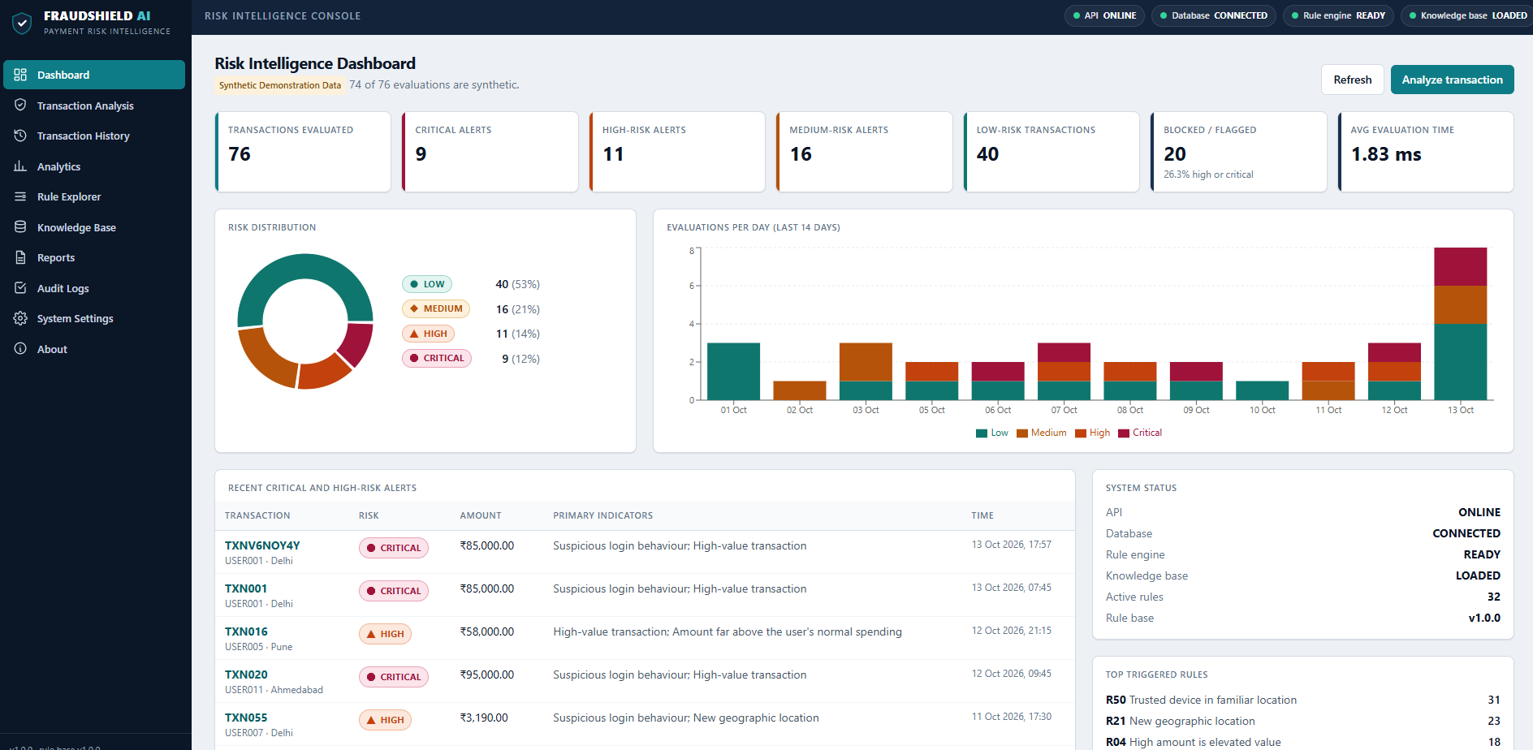
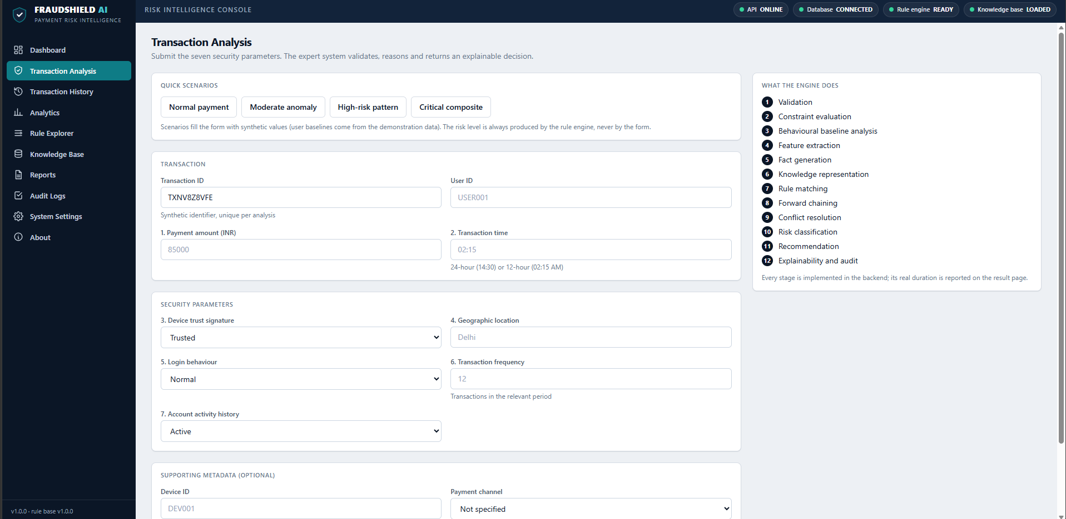
User Interface / Screenshots
Dashboard – evaluations, risk distribution, daily trend, recent critical and high-risk alerts, system status and top triggered rules.
Transaction Analysis – the seven security parameters are submitted; quick scenarios fill the form and the rule engine alone decides the risk level.

Slide 22
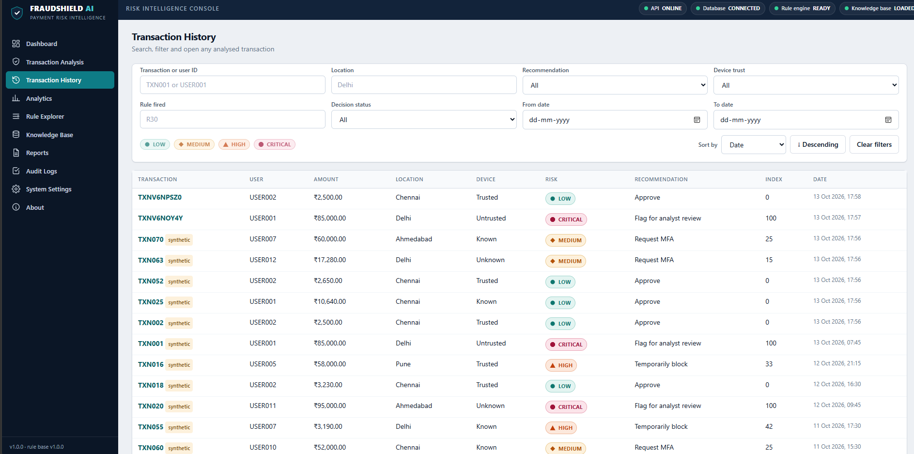
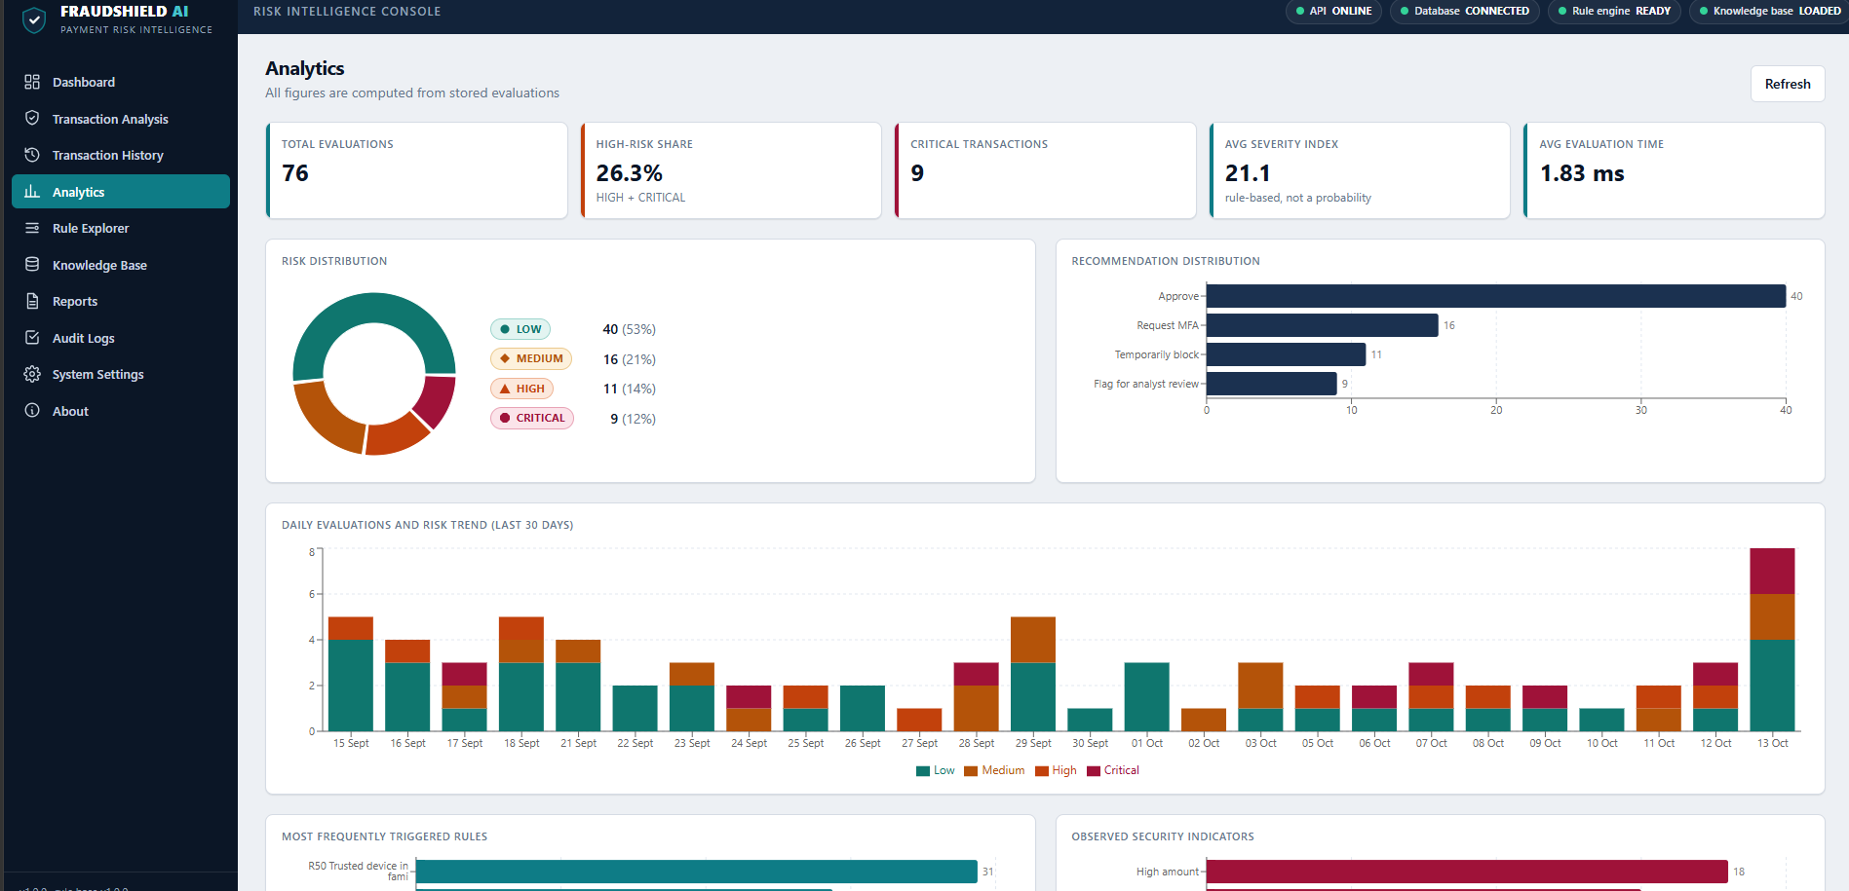
User Interface / Screenshots
Transaction History – search and filter by user, location, device trust, rule fired, decision status and date; each row shows risk and recommendation.
Analytics – risk distribution, recommendation distribution and the daily risk trend, computed from stored evaluations.

Slide 23
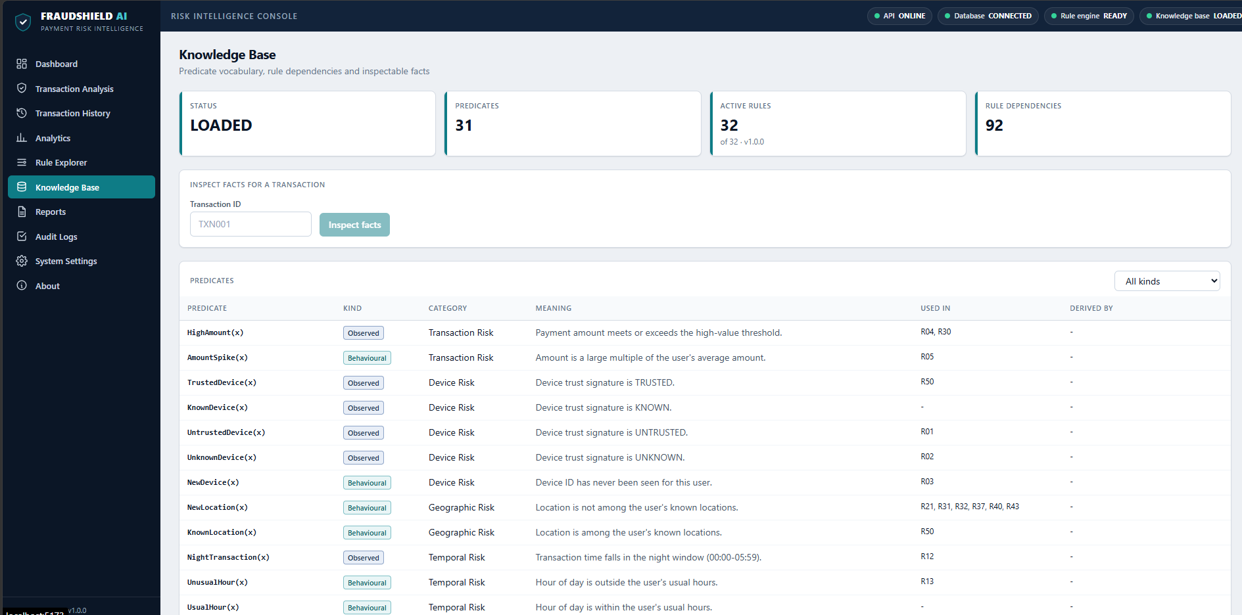
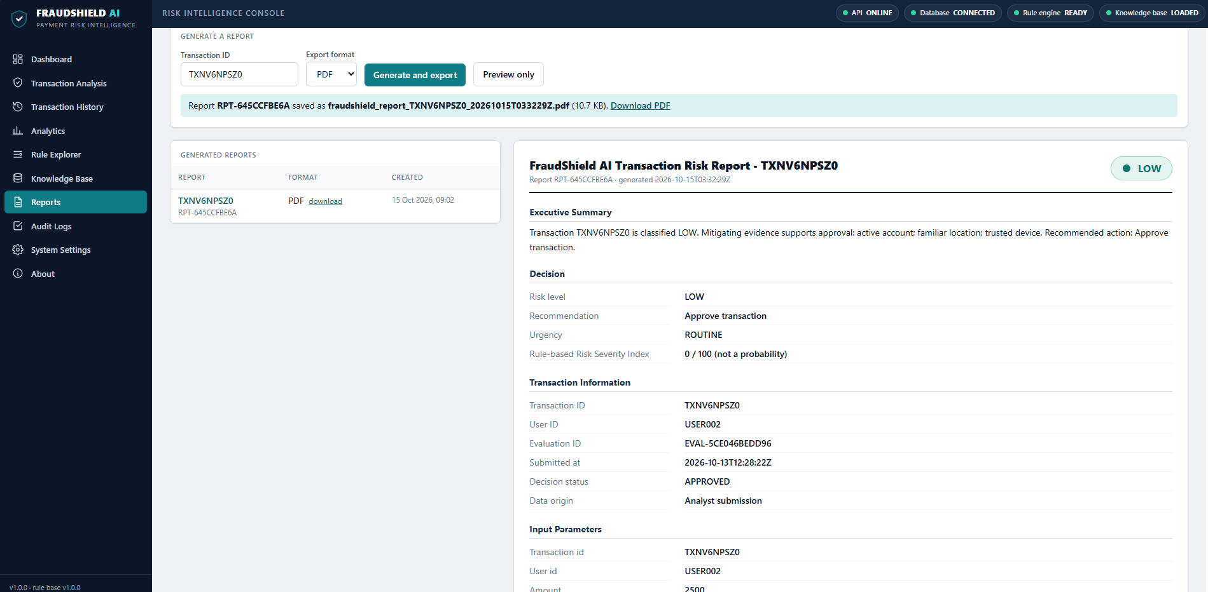
User Interface / Screenshots
Knowledge Base – predicate vocabulary (observed and behavioural), the rules that use each predicate, and fact inspection for a transaction.
Reports – generate and export a PDF risk report with executive summary, decision, input parameters and reasoning.

Slide 24
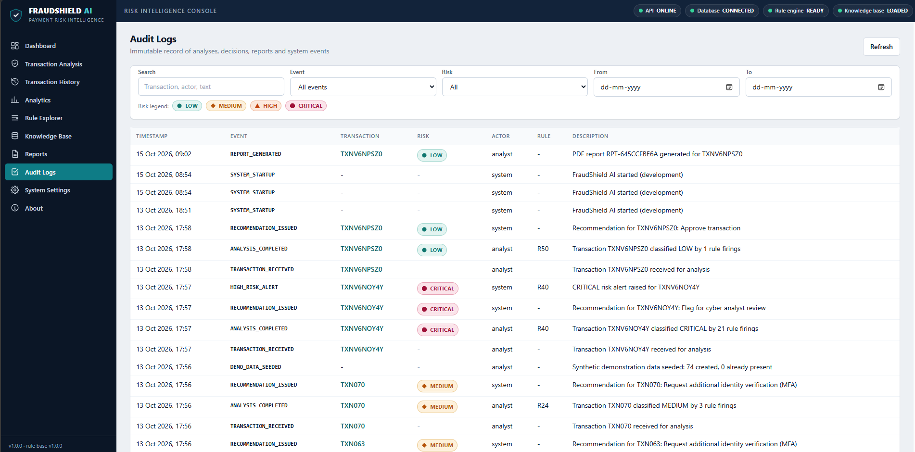
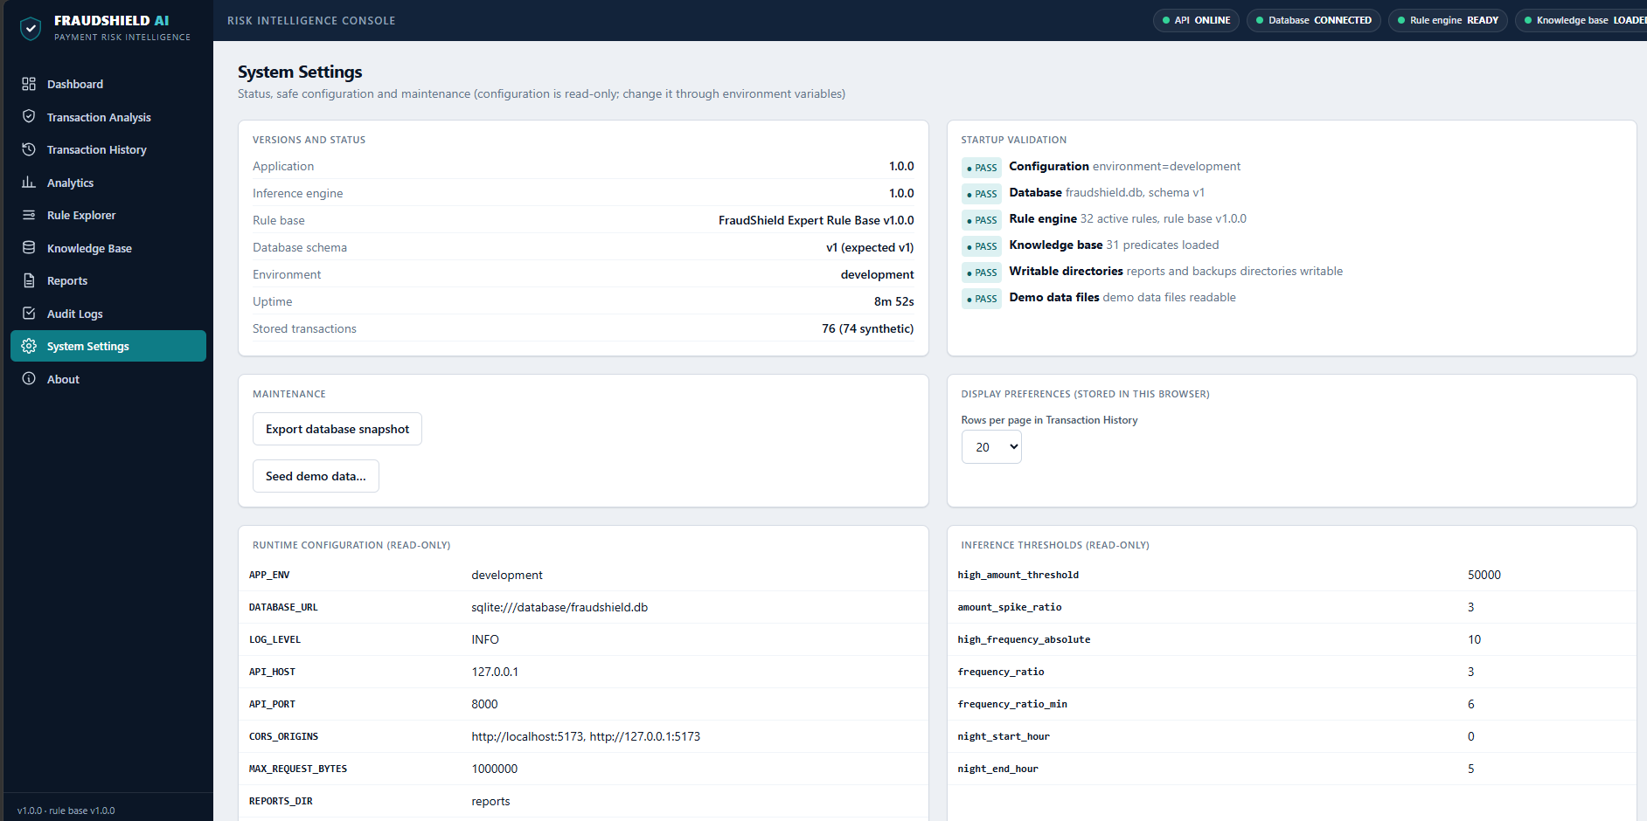
User Interface / Screenshots
Audit Logs – record of analyses, rule firings, recommendations, alerts and reports for traceability.
System Settings – versions, startup validation checks, read-only configuration and inference thresholds.

Slide 25
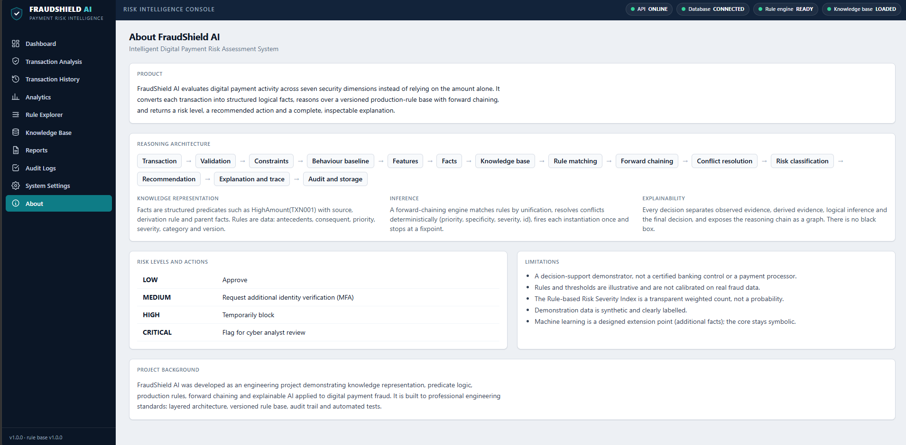
User Interface / Screenshots
About – reasoning architecture from transaction to audit, risk levels with recommended actions, and stated limitations.

Slide 26
Conclusion
FraudShield AI shows that a transparent expert system can assess digital payment risk from seven core inputs without any training data.
A versioned base of 32 rules over 31 predicates, run by forward chaining with deterministic conflict resolution, classifies each payment as LOW, MEDIUM, HIGH or CRITICAL.
Every decision is explainable and auditable through the rule trail, a PDF report and the audit log: TXN001 is CRITICAL and TXN002 is LOW.
On 76 stored evaluations (74 synthetic) the average evaluation time is 1.83 ms; rules and thresholds are illustrative, not calibrated on real fraud data.

Slide 27
Future Work
Calibration: tune rule thresholds and priorities on real, labelled fraud data with analyst feedback.
Richer inputs: add merchant, beneficiary and device-history facts to the knowledge base.
Rule editor: let analysts add, version and test rules from the web interface.
Machine learning as extra facts: a learned score can become one more fact while the symbolic core keeps the final decision.
Deployment: authentication, Docker packaging and a production database.

Slide 28
References
[1] C. L. Forgy, “Rete: A fast algorithm for the many pattern/many object pattern match problem,” Artificial Intelligence, vol. 19, no. 1, pp. 17–37, 1982.
[2] B. G. Buchanan and E. H. Shortliffe, Rule-Based Expert Systems: The MYCIN Experiments of the Stanford Heuristic Programming Project. Addison-Wesley, 1984.
[3] R. J. Bolton and D. J. Hand, “Statistical fraud detection: A review,” Statistical Science, vol. 17, no. 3, pp. 235–255, 2002.
[4] A. Dal Pozzolo, G. Boracchi, O. Caelen, C. Alippi and G. Bontempi, “Credit card fraud detection: A realistic modeling and a novel learning strategy,” IEEE Trans. Neural Networks and Learning Systems, vol. 29, no. 8, pp. 3784–3797, 2018.
[5] M. T. Ribeiro, S. Singh and C. Guestrin, “‘Why should I trust you?’: Explaining the predictions of any classifier,” in Proc. ACM SIGKDD (KDD 2016), pp. 1135–1144, 2016.
[6] A. Adadi and M. Berrada, “Peeking inside the black-box: A survey on explainable artificial intelligence (XAI),” IEEE Access, vol. 6, pp. 52138–52160, 2018.
[7] S. Russell and P. Norvig, Artificial Intelligence: A Modern Approach, 4th ed. Pearson, 2020.
[8] FastAPI documentation, https://fastapi.tiangolo.com
[9] Deepan S A and Barathraj M, “FraudShield AI” (source code), FraudShield_AI.zip, 2026.

Slide 29
Thank You

